Slide 1
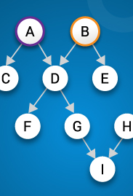
Causal Models in Machine Learning and its Applications in Healthcare
Hiram G. Menendez
Springboard Alumni
Image from edureka.co

Slide 2
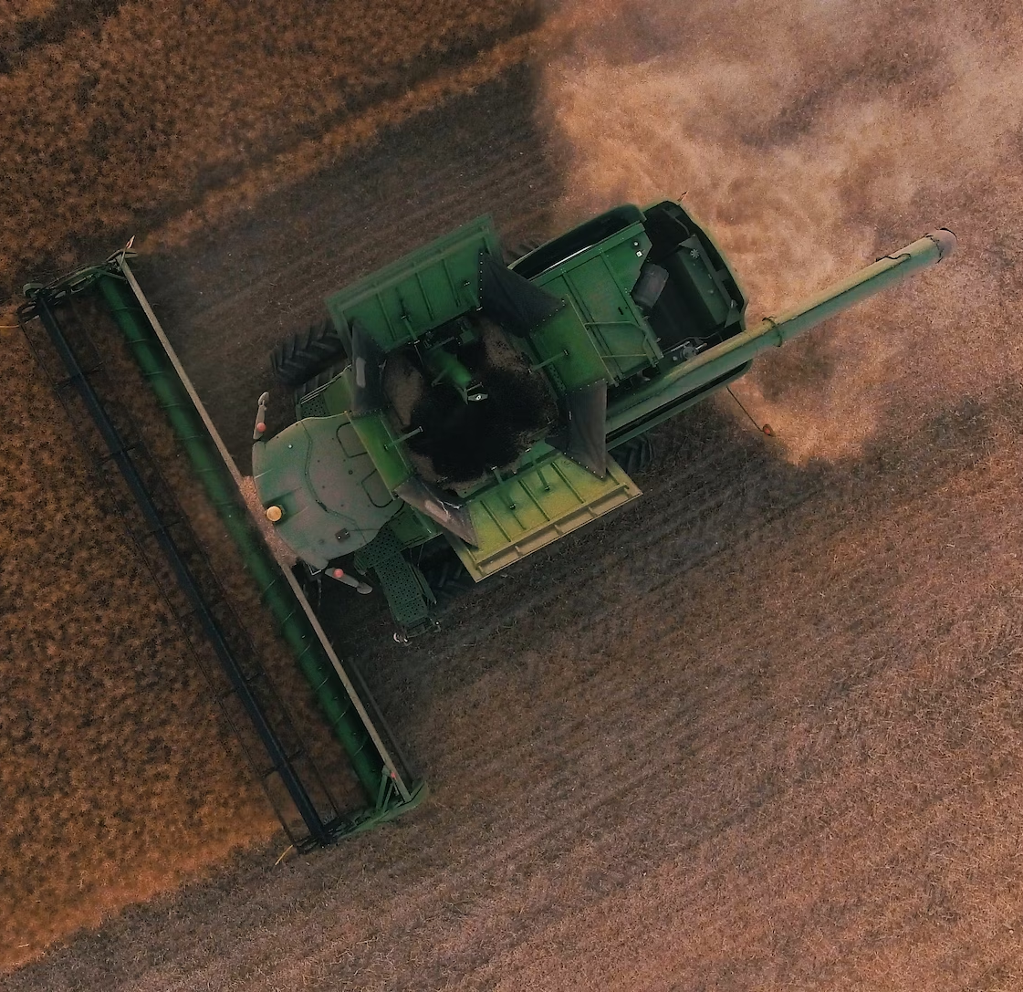
Imagine the following scenario...
Your team builds a Machine Learning Model that predicts crop yield.
The models predictions have been valuable to the business.
The features might include:
Time of the year
Sunlight exposure time
Fertilizer concentration
Etc.
You notice the model tends to predict higher crop yield when the temperature is lower than the daily average.
Photo by Tomas Hertogh on Unsplash

Slide 3

What would you do?
Based on this observation, you (the business manager) decide invest in (expensive) climate control infrastructure to keep temperatures low.
Would you make this decision?
Photo by Yiorgos Ntrahas on Unsplash

Slide 4
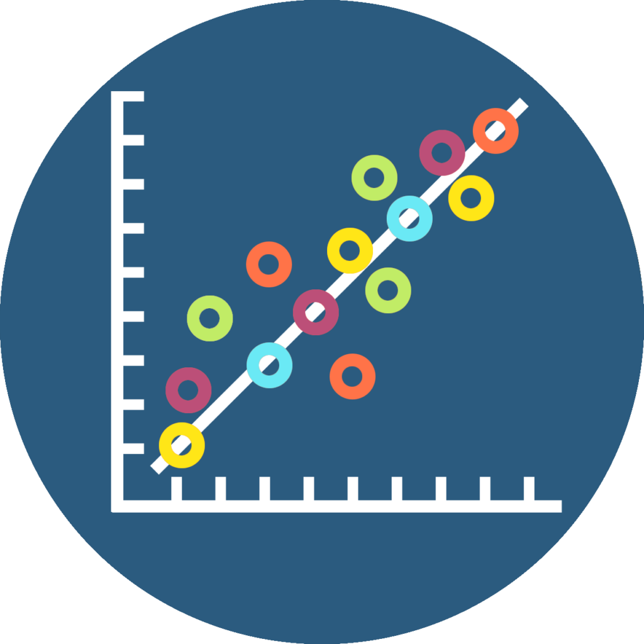
Correlation does not imply Causation
A lot of well-known machine learning algorithms are predictive.
However, they are not causal.
Image from https://ctil.dundee.ac.uk/

Slide 5
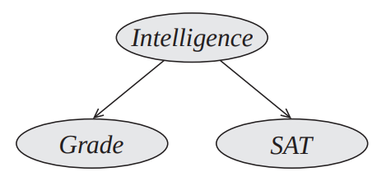
Example: Confounders
"The Student" example from
Koller D. and Friedman N. (2009). Probabilistic Graphic Models: Principles and Techniques
Directed Acyclic Graphs (DAGs) are used to describe causal relationships
"Grade" is correlated with "SAT"
Does getting a good grade "cause" your SAT score to go up?

Slide 6
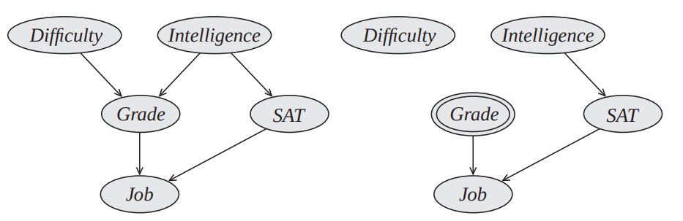
Interventions
"The Student" example from
Koller D. and Friedman N. (2009). Probabilistic Graphic Models: Principles and Techniques
Original Model
"Mutilated" model after intervention
If you hack into the school computer system and set your grade to an "A", would your chances of getting a high score on the SAT increase?

Slide 7
Discovering the Causal Structure
"X" and "Y" are correlated. What is the correct causal structure?
Z
X
Y
X
Y
X
Y
Cannot be determined from observations alone

Slide 8

Important Notes
Observations (Probability Distribution) does not tell you the causal structure.
Intervening on the mechanism that generates the random variables tells you the causal structure. (Experiments)
Observations can "narrow down" the list of possible causal graphs.
Causation can also be established by expert knowledge.
Expert knowledge, machine learning methods, and assumptions are needed to build causal models
Photo by AbsolutVision on Unsplash

Slide 9
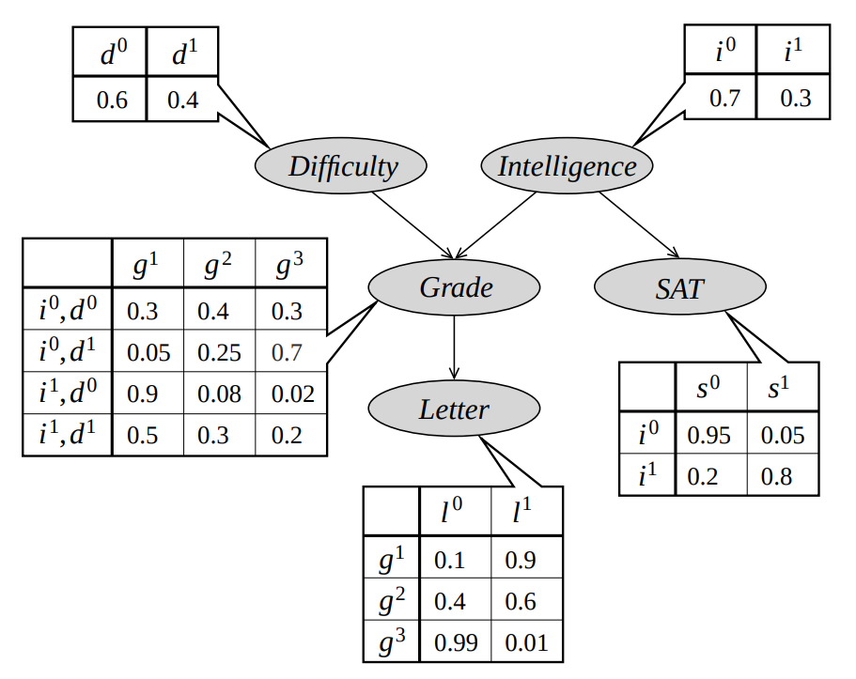
Bayesian Networks
Graph + Parameters = Probability Distribution

Slide 10
Learning Graphical Models
Possible goals of building a graphical model:
Density Estimation: find the correct probability distribution.
Allows you to perform queries.
Examples:
P(Job = yes | Intelligence = Low, SAT = High)
P(Job = yes | do(Grade) = High) *Interventional Query
Specific Task:
Example: Classification Task
Knowledge Discovery: what is the causal structure of my data?
Example: "Having a high grade does not 'cause' a high SAT score"
Each of these goals will use different metrics to define success.

Slide 11
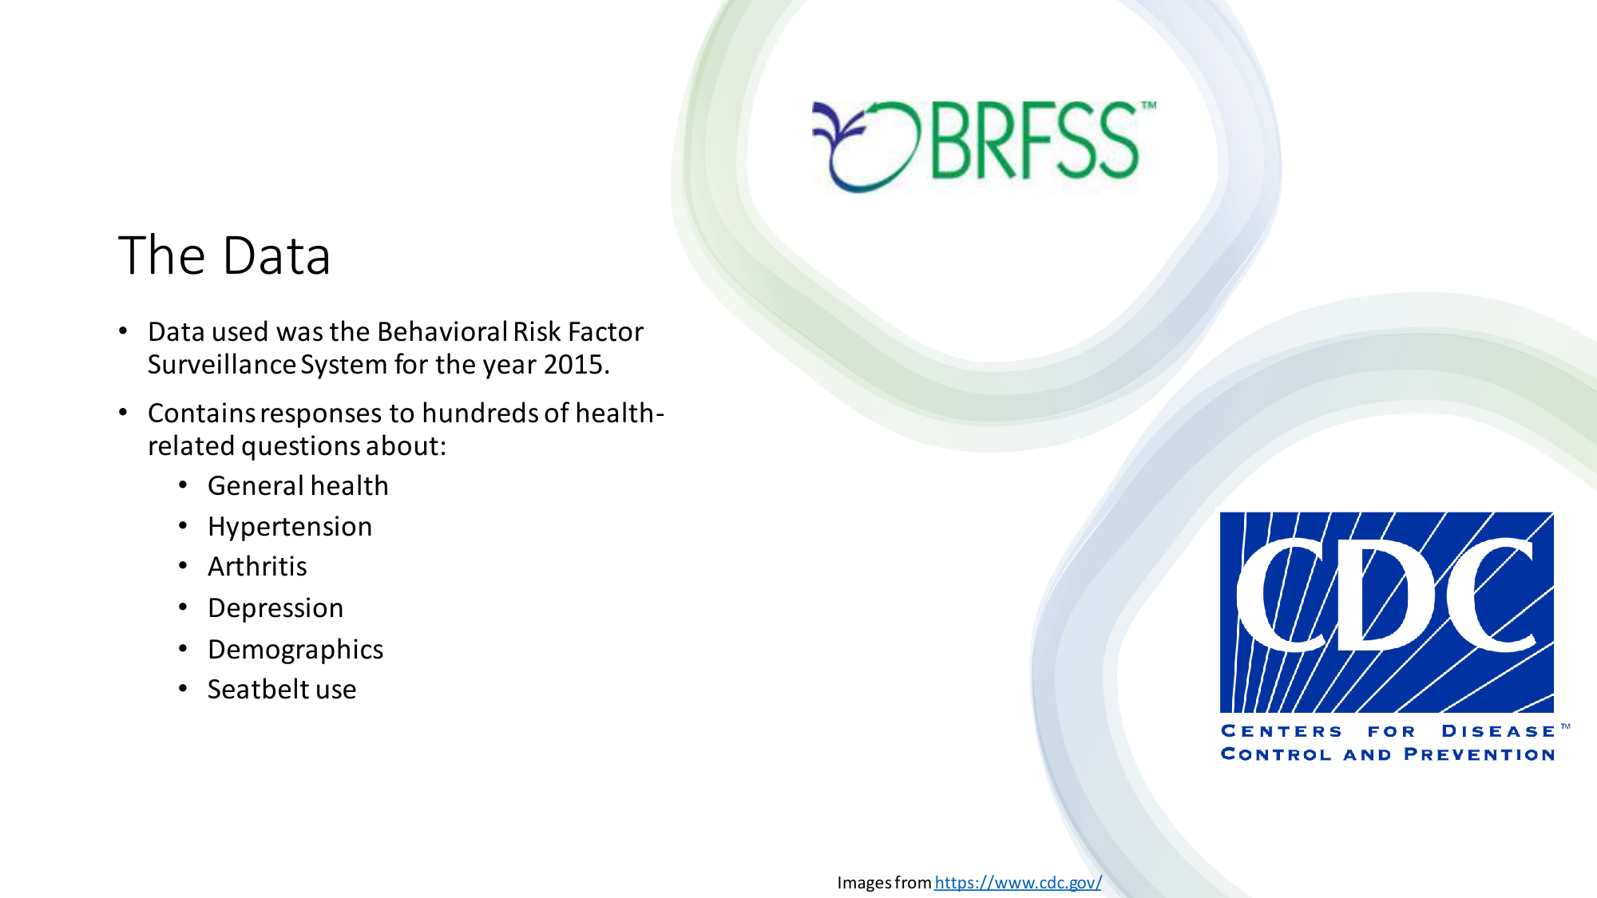

Slide 12
Capstone Project 3 Goals
Goal #1: build a BN classifier for coronary artery disease.
Goal #2: discover causal structure
What causes coronary artery disease?
Goal #3: Make interventional queries
Example: If I make a patient stop smoking, how will the chances of having coronary artery disease change?

Slide 13
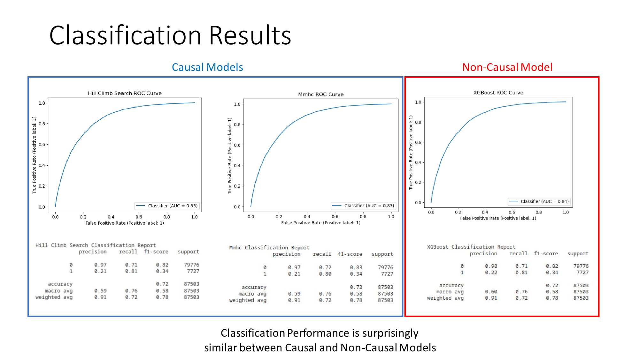
Results: Classification Task

Slide 14
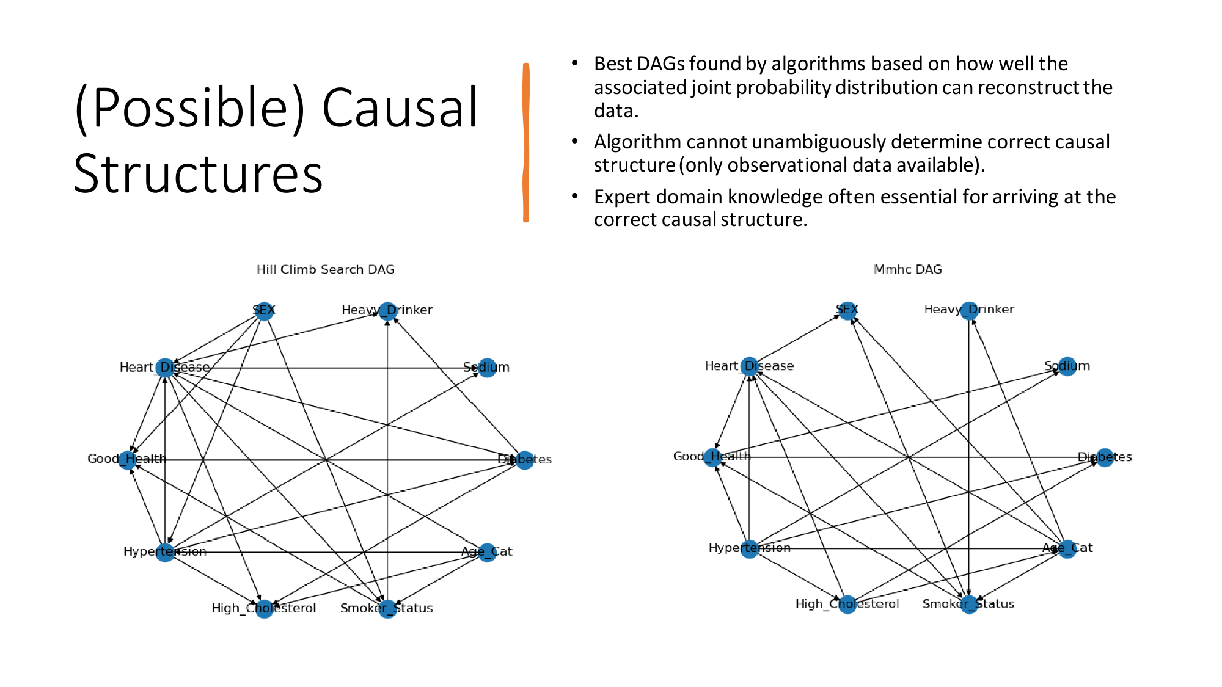

Slide 15
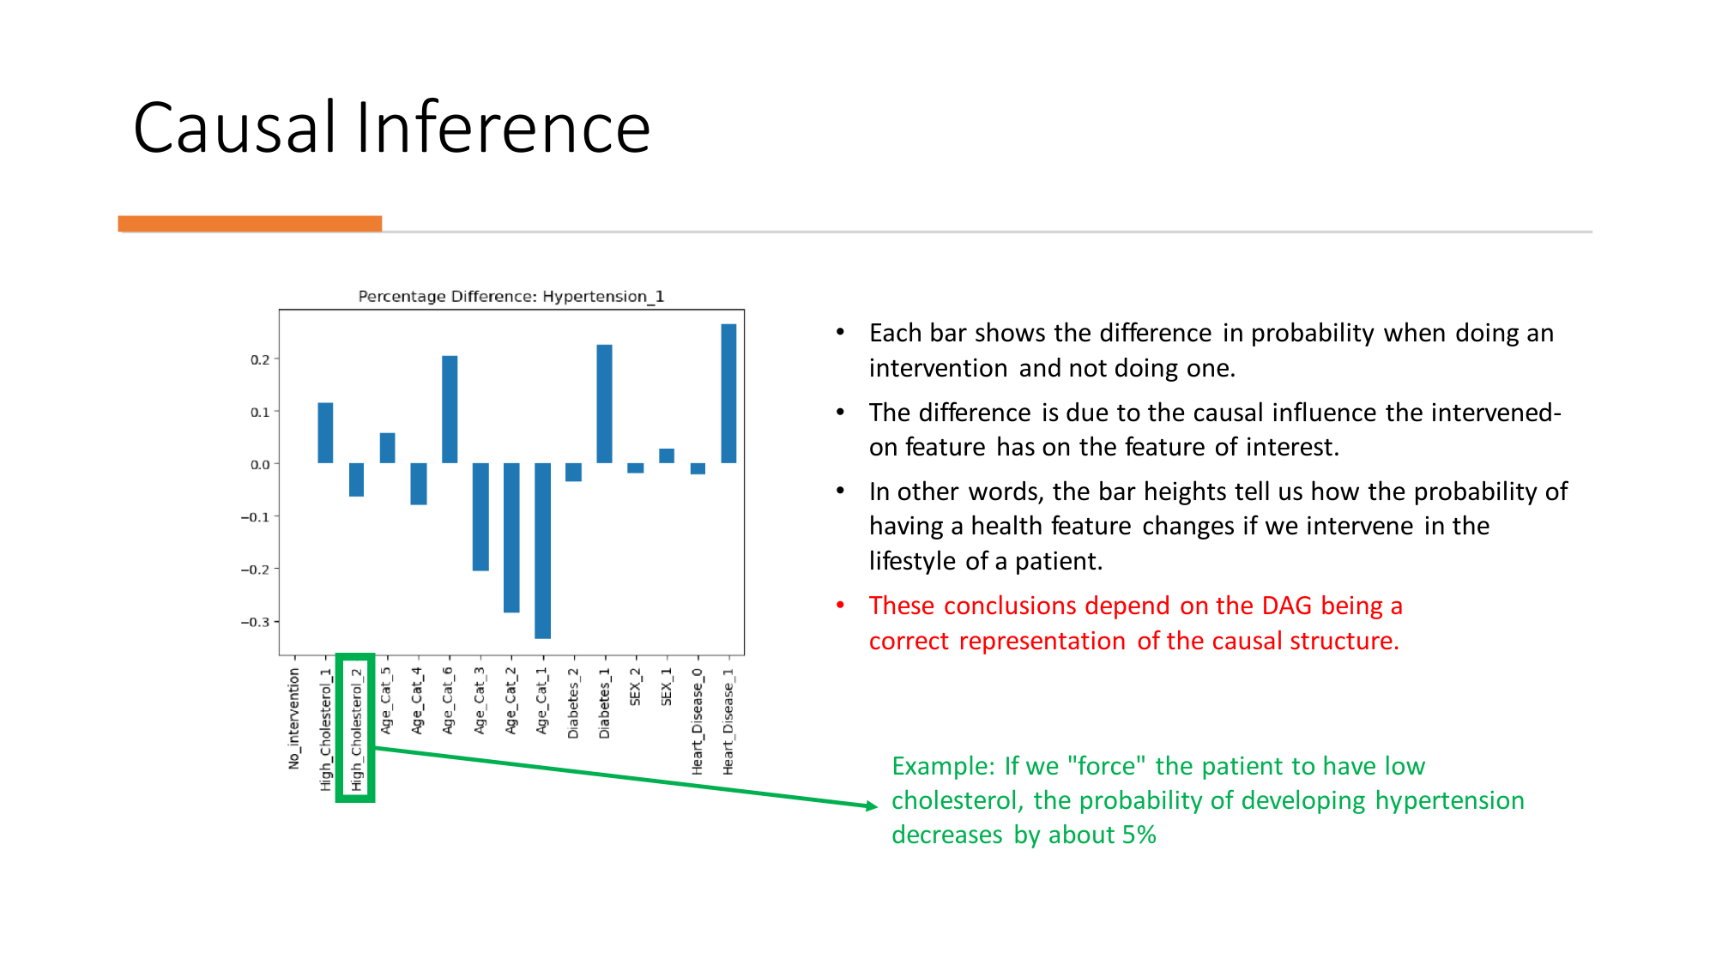

Slide 16
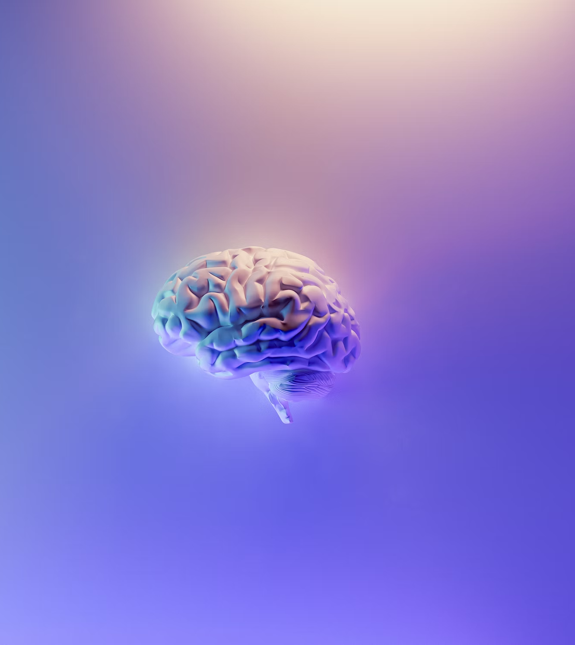
Summary
Traditional Machine Learning Algorithms learn from data, but they cannot establish causal relationships between features.
Bayesian Networks are models that make predictions about data taking into account the causal structure of the data.
The causal structure of data cannot be established from observational data alone.
In my project, Bayesian Networks performed as well as non-causal models in classification tasks.
Bayesian Networks can make causal inquiries about the data, but it relies on the accuracy of the DAG.
Photo by Milad Fakurian on Unsplash

Slide 17
Thank you!

